Slide 1
Opportunity Youth Labor Report
2024

Slide 2
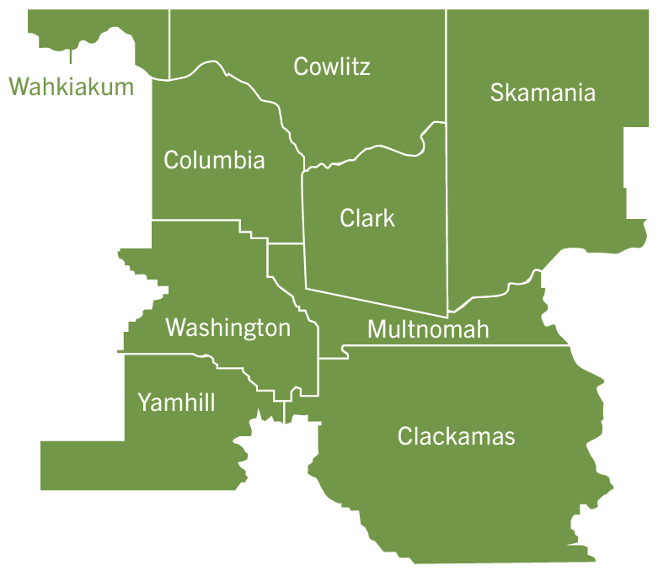
The Columbia-Willamette Workforce Collaborative
The Columbia-Willamette Workforce Collaborative (CWWC) is a partnership between Clackamas Workforce Partnership, Workforce Southwest Washington, and Worksystems: the three Workforce Development Boards covering the Portland-Vancouver Metropolitan Area.
The CWWC delivers a unified approach to serving industry, supporting economic development, and guiding public workforce training investments to better address the needs of our combined labor shed. We know that people are willing to travel throughout the region for the best opportunities and that employers need the most qualified workers regardless of where they live. By working together, we can cultivate our regional talent pool and build the foundation for a strong economy.
Notes:
Why & What: To carry out our work, Worksystems conducts careful, in-house research and analysis of a range of data on the regional labor market, broader economic conditions, demographic trends, quality-of-life indicators, and more. This helps guide our training investments, identify growing and emerging sectors of industry, define the characteristics of <Quality Jobs>, and advance the region’s capacity to understand and align regional workforce supply with industry demand. ​
​
This approach helps ensure that our training funds are invested where they can have the maximum impact, advance equitable prosperity in our region, and help us remain nimble and able to address the shifting needs of industry. ​

Slide 3
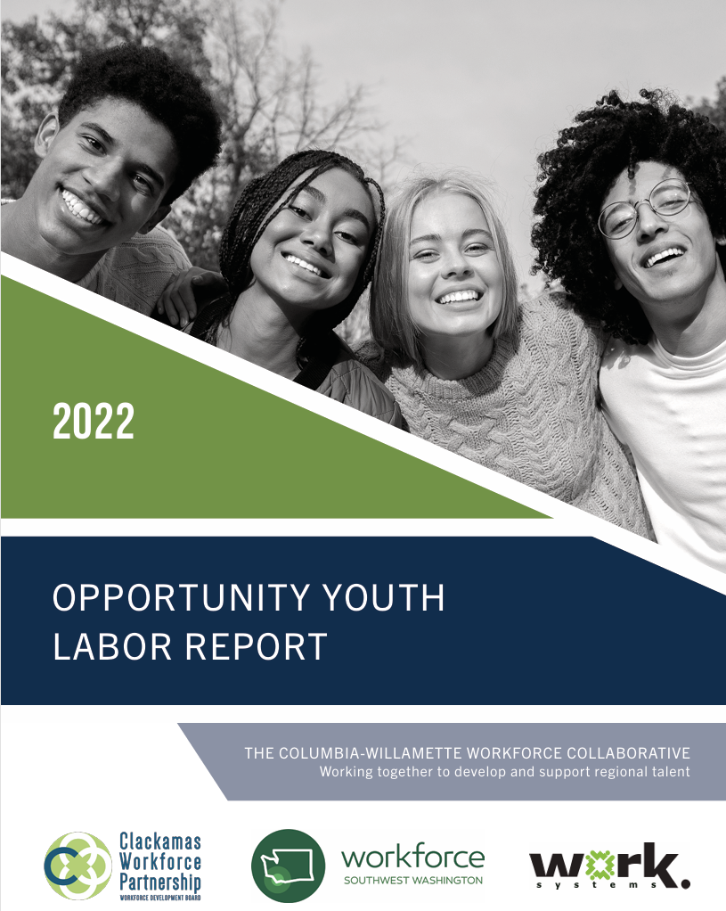
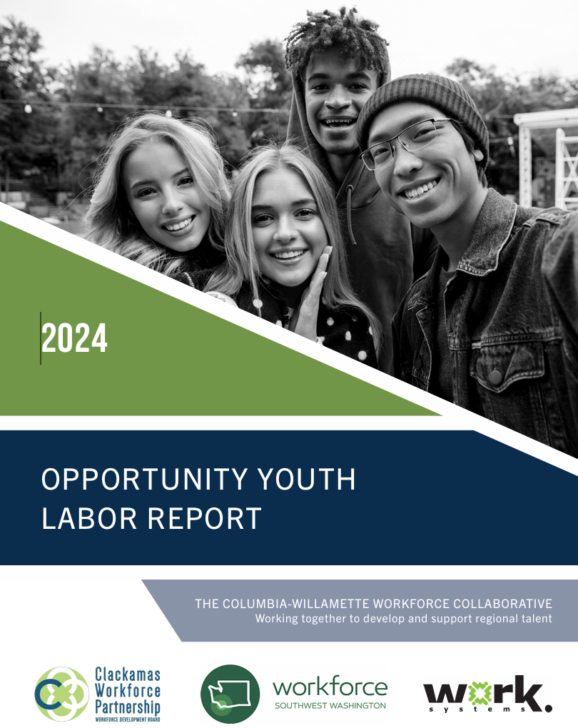
Tracking Opportunity Youth Since 2016
Notes:
​

Slide 4
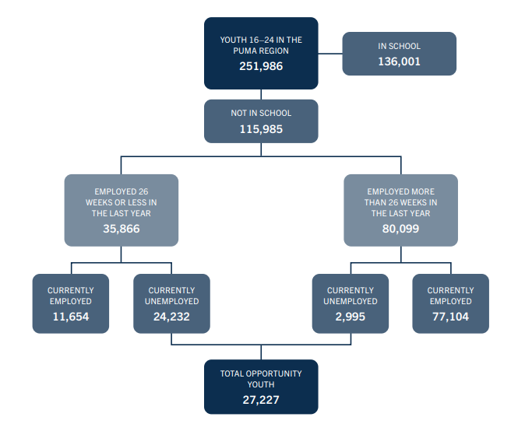
Opportunity Youth, 2022
Opportunity Youth are 11% of all youth in the CWWC region
11% of youth in Washington State are Opportunity Youth
12% of youth in Oregon are Opportunity Youth
The number of Opportunity Youth in the CWWC region dropped by 21% between 2020 and 2022.
The total youth population declined 15%.
Source: Worksystems analysis of US Census data

Slide 5
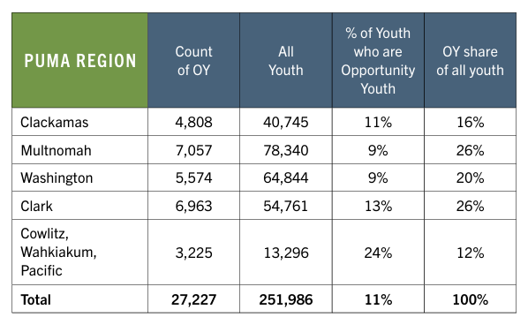
Opportunity Youth Geography
Multnomah and Clark Counties have the highest number of Opportunity Youth
24% of youth in Cowlitz, Wahkiakum, and Pacific Counties are Opportunity Youth
The number and the percentage of Opportunity Youth declined in every region but Cowlitz, Wahkiakum, and Pacific Counties.

Slide 6
Opportunity Youth Overview
Age
Poverty
Race & Ethnicity
Sex

Slide 7
Education
High School Graduation Rates & Community College Enrollment

Slide 8
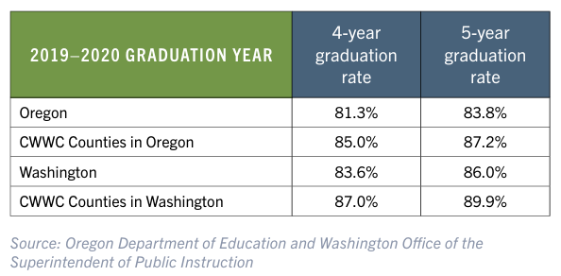
High School Graduation

Slide 9
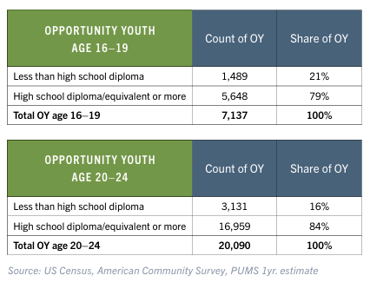
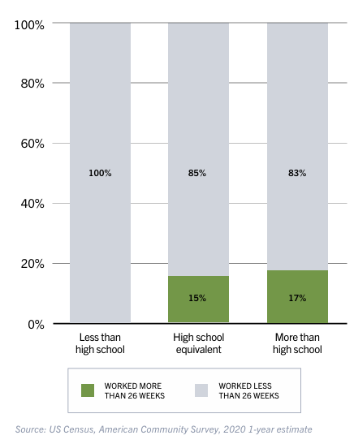
High School Graduation & Employment
Significant Employment by Education Level Youth age 16-24, Not in School, 2022
Significant Employment by Education Level Youth age 16-24, Not in School, 2022

Slide 10
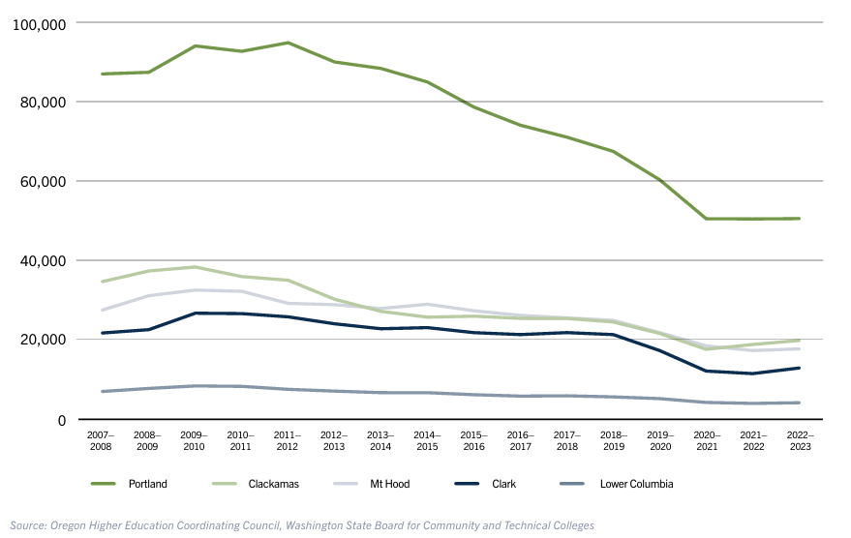
Community College Enrollment
Community College Enrollment, PVMA, 2007-2023
48% fewer students enrolled in community colleges in 2022-2023 from the peak of enrollment in 2009-2010.

Slide 11
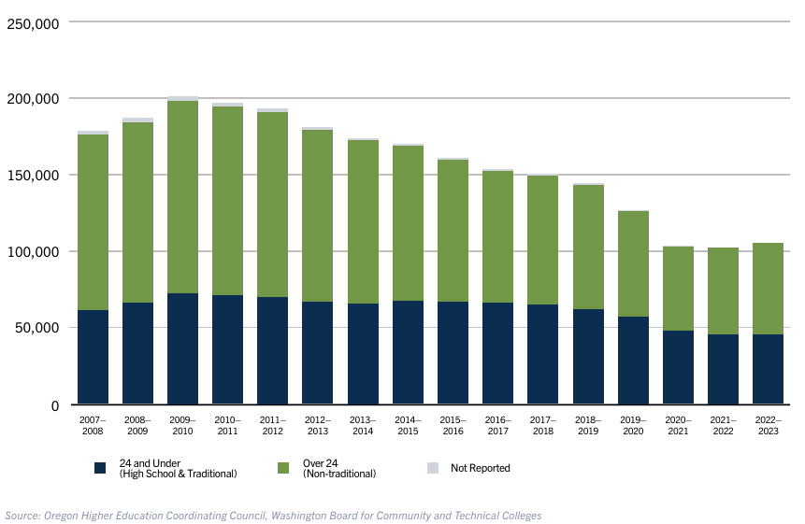
Community College Enrollment
Community College Enrollment, by Age, PVMA, 2015-2023
The number of students 24 years or younger enrolled in regional community colleges declined 26% between the 2007-2008 academic year and the 2022-2023 academic year.

Slide 12
Labor Force Participation & Unemployment
Youth participation in the labor force is down while youth unemployment is up.

Slide 13
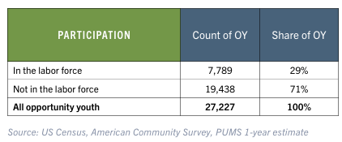
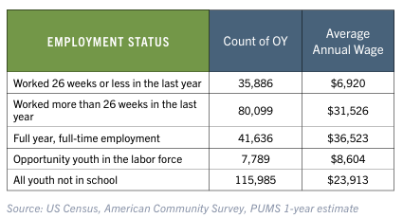
Labor Force Participation & Unemployment
Labor Force Participation Among Opportunity Youth, PVMA, 2022
71% of all opportunity youth were not in the labor force
This represented a three-point increase from 2016 and a thirteen-percentage point increase in share compared to 2014, when 61% of opportunity youth were estimated to be out of the labor force.
Since 2019 there are
5% fewer jobs in Arts, Entertainment, and Recreation
6% fewer jobs in Accommodations and Food Services
2% fewer jobs in Retail Sales
Annual Wages for Youth Not in School, by Level of Employment Status, PVMA, 2022

Slide 14
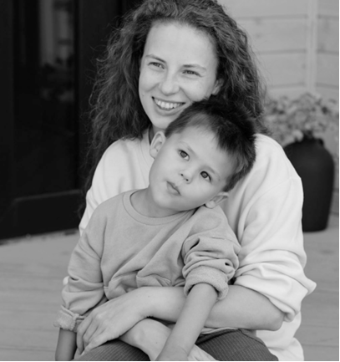
Caregiving Youth
Balancing the demands of caregiving with education and paid labor

Slide 15
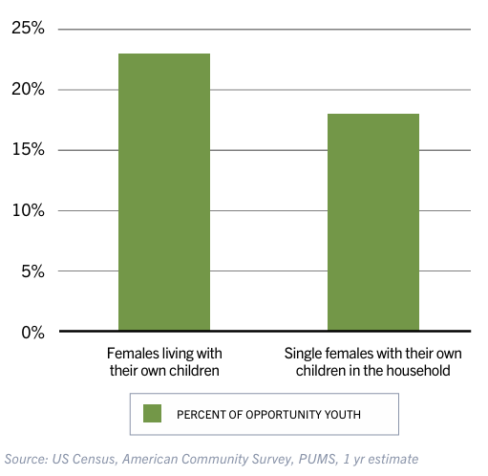
Caregiving Youth
Opportunity Youth Females by Household Type and Own Children in the Household, PVMA, 2022
23% of female opportunity youth (2,700) lived with their own children in 2022.
For teens who do become parents, the chance of becoming an opportunity youth is high. 57% (2,200) of the female youth aged 16 to 24 who gave birth during the past year, were opportunity youth.
60% of single mother households in Oregon and 80% of single mother households in Washington do not earn enough to make ends meet.

Slide 16
Health Insurance & Mental Health
Health Insurance Coverage Rates Decline as Mental Healthcare Needs Increase

Slide 17
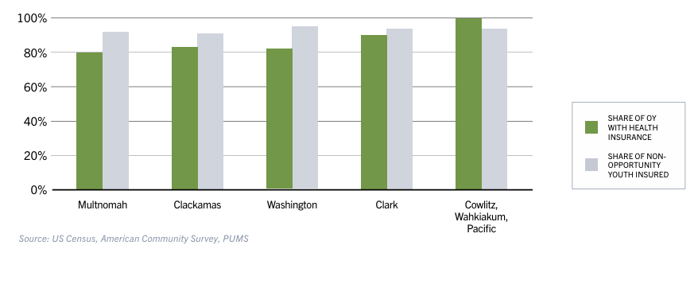
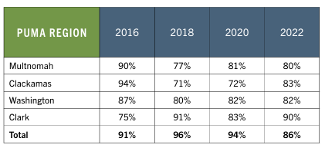
Health Insurance Coverage & Mental Health
Opportunity Youth with Health Insurance, CWWC, 2022
In 2022, just 86% of opportunity youth had health insurance coverage. This is nearly ten percentage points lower than for the total population.
Share of Youth who are Insured, by PUMA, 2022
In 2023, Oregon ranked 50th in the nation for youth mental health.
Washington ranked 39th, with 14% of youth reporting poor mental health.
19% of youth in Oregon and 15% of youth in Washington say they’ve experienced a major depressive episode.
64% of youth who experienced a major depressive episode did not receive medical care

Slide 18
Additional questions about the regional labor market?
Just ask!
Liza Morehead, PhD
Research & Data Analyst, Worksystems
lmorehead@worksystems.org

